Slide 1

CROSSWALK DETECTION
Group 2

Slide 2
Overvıew
Introduction
Overview of the Dataset and EDA
Model Development
Results and Evaluation
Challenges Faced
Conclusion and Future Potential Work

Slide 3
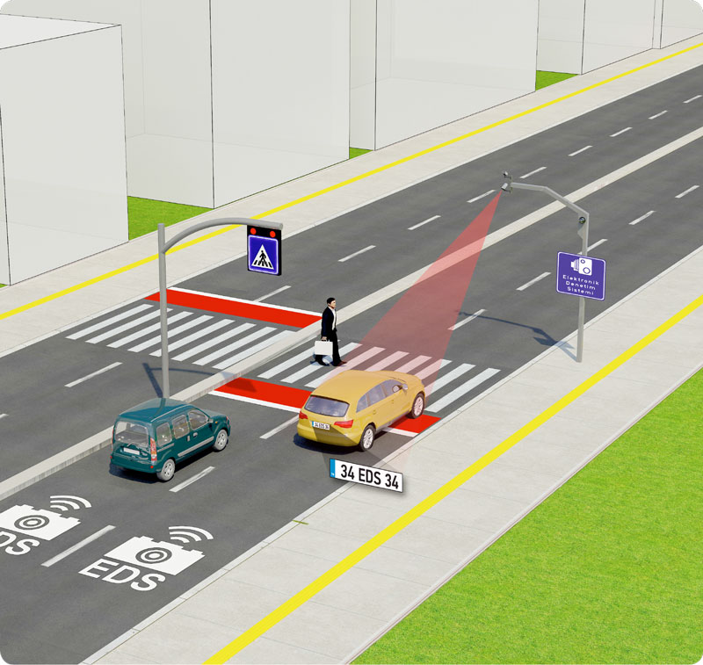
ıntroductıon

Slide 4
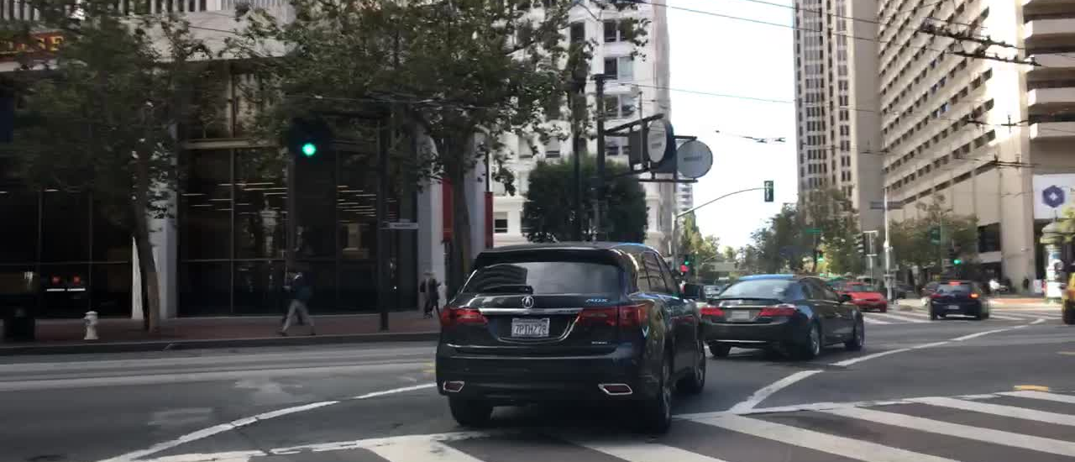
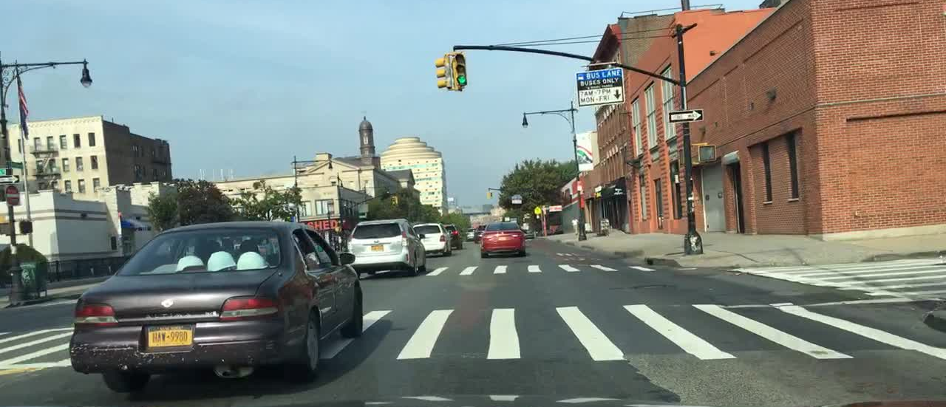

Dataset: bdd100k
Total number of images in dataset | 70000
Total number of images with crosswalk | 25637
Average crosswalk number per image | 5
Maximum crosswalk number per image | 5
Minimum crosswalk number per image | 1
Image Size | 1280x720

Slide 5
MODEL DEVELOPMENT
Decision Tree
Naive Bayes
K-Nearest Neighbour
Logistic Regression
YOLO

Slide 6
Decısıon tree
 | Precision | Recall | F1-Score | Support
No Cross. | 0,74 | 0,73 | 0,74 | 8845
Crosswalk | 0,55 | 0,57 | 0,56 | 5155
Macro avg. | 0,65 | 0,65 | 0,65 | 14000
Weighted avg. | 0,67 | 0,67 | 0,67 | 1400
Accuracy | 67,08%

Slide 7
NAIVE BAYES
 | Precision | Recall | F1-Score | Support
No Cross. | 0,80 | 0,66 | 0,73 | 8845
Crosswalk | 0,57 | 0,76 | 0,65 | 5155
Macro avg. | 0,69 | 0,71 | 0,69 | 14000
Weighted avg. | 0,73 | 0,70 | 0,70 | 1400
Accuracy | 69,61%

Slide 8
K-nn
 | Precision | Recall | F1-Score | Support
No Cross. | 0,78 | 0,81 | 0,80 | 8845
Crosswalk | 0,66 | 0,61 | 0,63 | 5155
Macro avg. | 0,72 | 0,71 | 0,71 | 14000
Weighted avg. | 0,74 | 0,74 | 0,74 | 1400
Accuracy | 73,86%

Slide 9
Logıstıc regressıon
 | Precision | Recall | F1-Score | Support
No Cross. | 0,83 | 0,88 | 0,86 | 8845
Crosswalk | 0,78 | 0,70 | 0,73 | 5155
Macro avg. | 0,81 | 0,79 | 0,80 | 14000
Weighted avg. | 0,81 | 0,81 | 0,81 | 1400
Accuracy | 81,45%

Slide 10
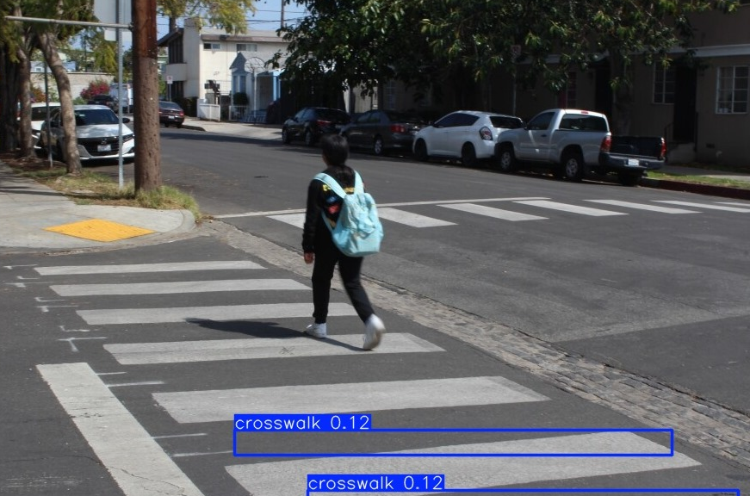
YOLO (Epochs: 10, Image Size: 640, Dataset: 1103, CPU)

Slide 11
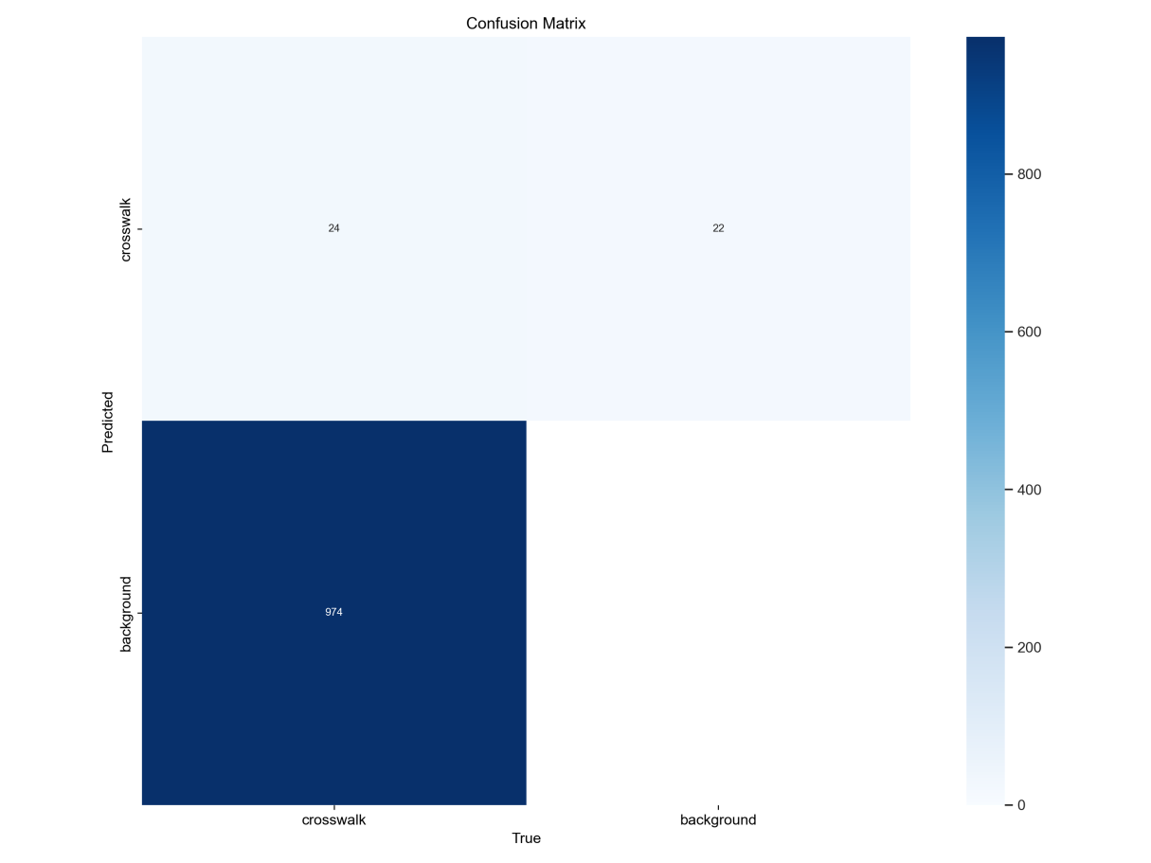
YOLO (Epochs: 10, Image Size: 640, Dataset: 1103, CPU)

Slide 12
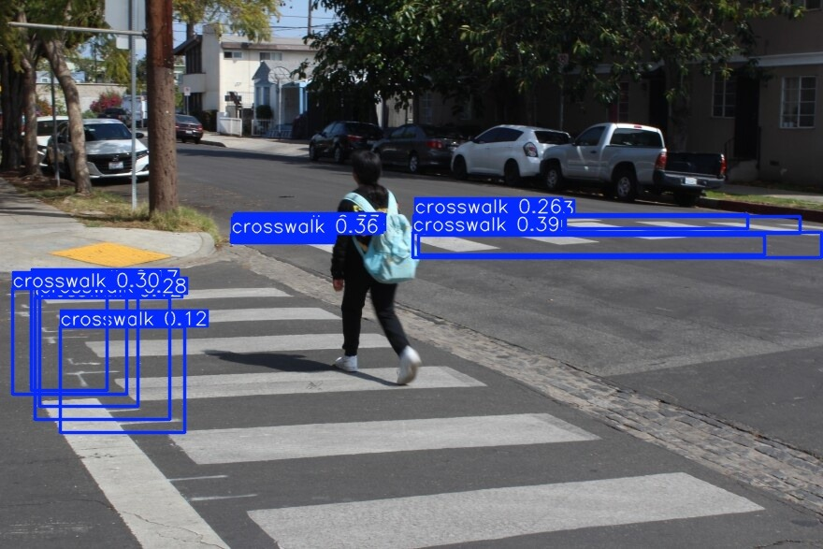
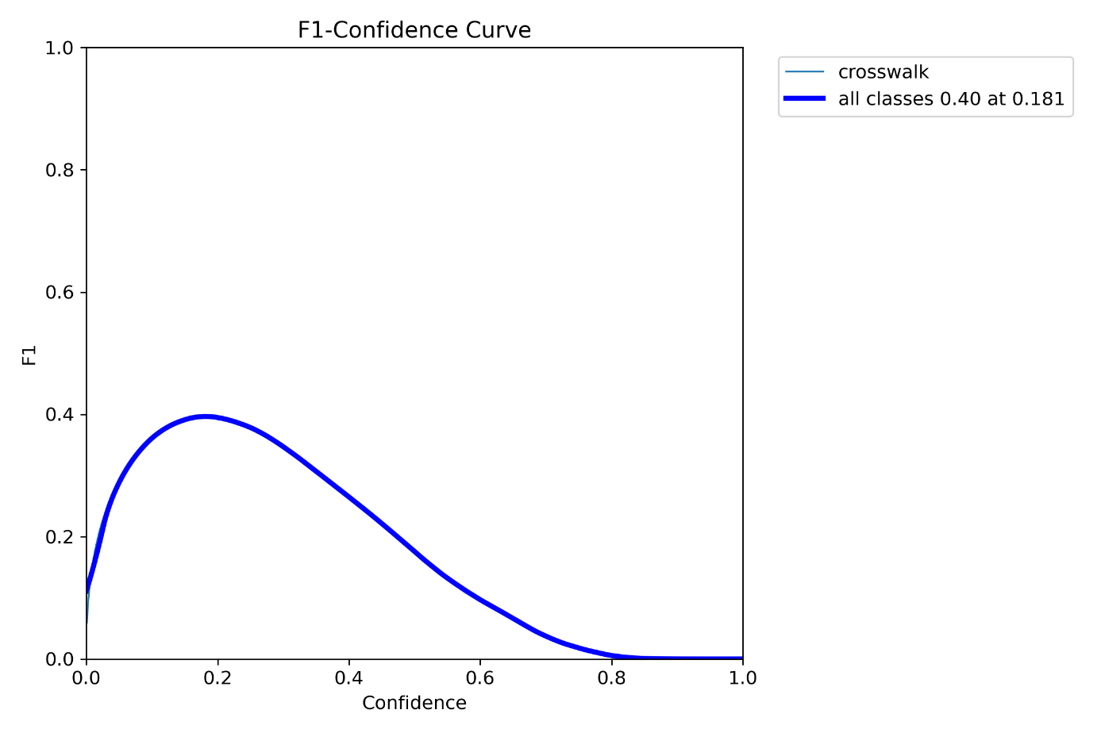
YOLO (Epochs: 10, Image Size: 768, Dataset: 25637, GPU)

Slide 13
YOLO (Epochs: 10, Image Size: 768, Dataset: 25637, GPU)

Slide 14
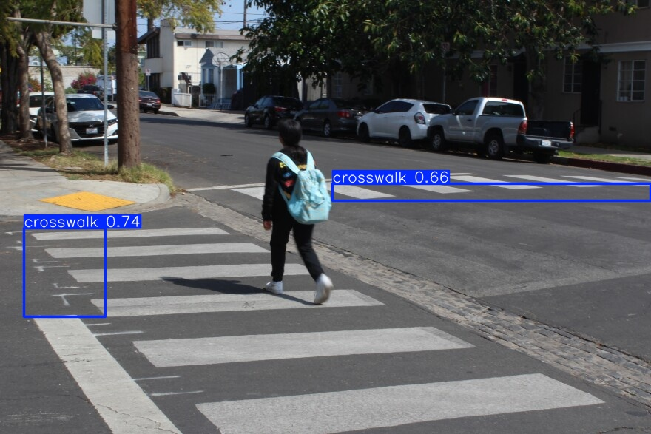
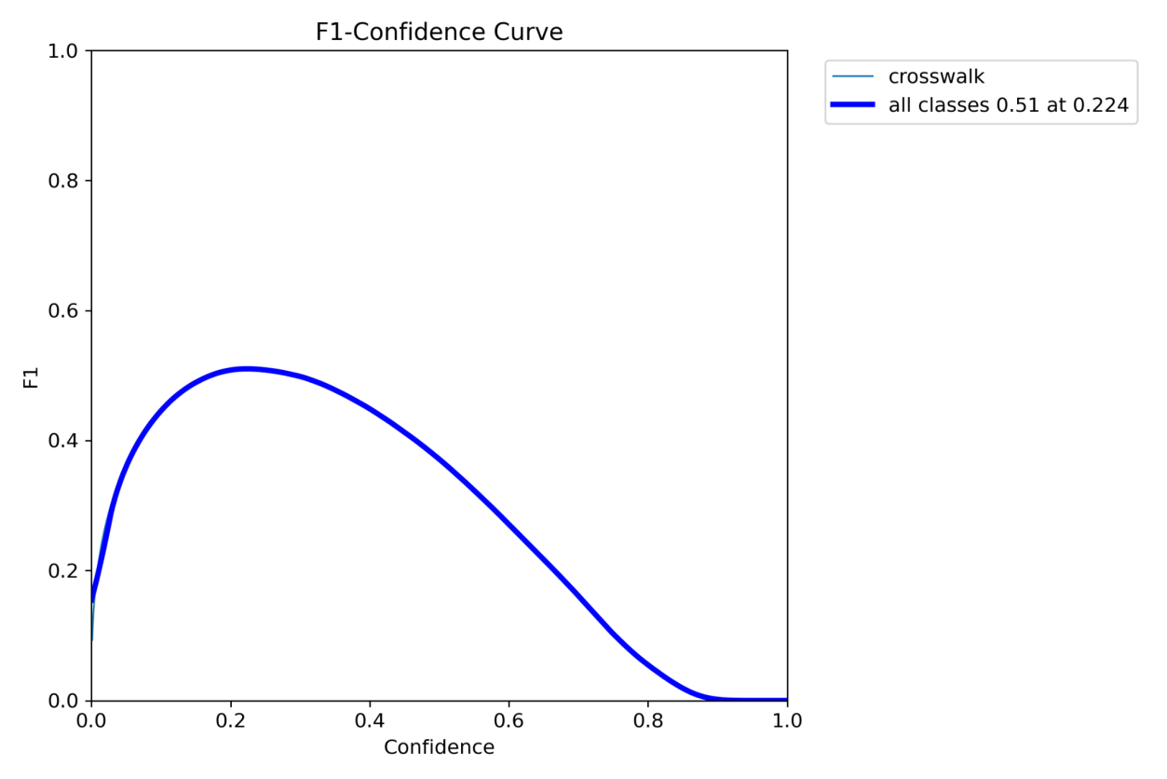
YOLO (Epochs: 50, Image Size: 1024, Dataset: 25637, GPU)

Slide 15
YOLO (Epochs: 50, Image Size: 1024, Dataset: 25637, GPU)

Slide 16
CHALLENGES
Logistic Regression
Imbalance in set
Logistic regression converging
YOLO
Training time
Overfitting
Variety of images

Slide 17
conclusıon
Best classification model
Logistic Regression with 81,45% accuracy
Disadvantages of classification models
Only binary classification
YOLO advantages
Object detection with boundaries
YOLO disadvantages
Huge training time
Low accuracy in setting boundaries

Slide 18
FURTHER POTENTIAL WORK
Data cleaning
Setting new parameters for YOLO training

